Slide 1
Sharing the abundance in Mexico: A Food Rescue Program for A New World
Dr. Kent Davis-Packard
Founder & President of Women Forward International
Marta Chicano
Director of Strategic Partnerships
Dr. Roberto Salinas, WFI Board Member

Slide 2
A STORY THAT NEEDS TO BE TOLD AND LIVED: In 2019, Women Forward International (WFI) began as a unique NGO, launched at Washington’s historic Aspen Institute. WFI’s support for partnerships between universities around the world and organizations in over a dozen countries today has made it possible for companies, non-profits, and governments to have credible research demonstrating that advancing women helps them better meet their overall mission. This data has led to action.
We have already seen the results of our projects as they blossom into a food rescue program for women in Mexico, a women’s university without walls in Afghanistan, and the inclusion of refugee and migrant women in European society and political life. Now we invite you to join us.

Slide 3
Our Vision (Noble Purpose)
In Global, Social and Economic Affairs,
To Put the Mind in Service of the Heart:
Love in Action

Slide 5
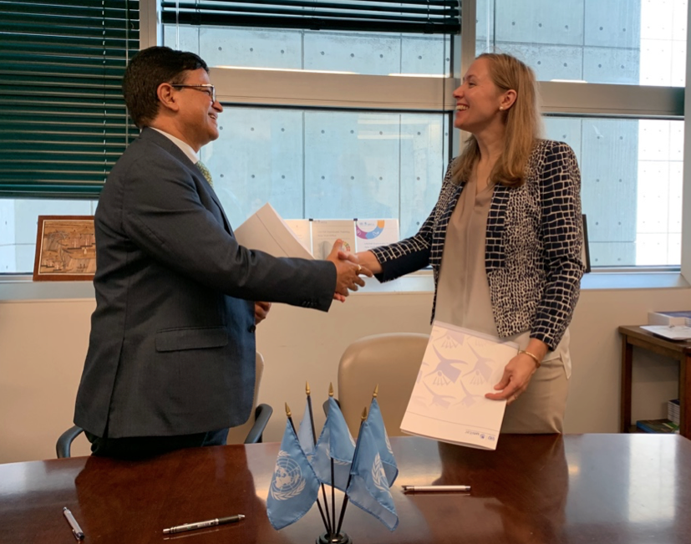
The United Nations has identified WFI as key to attaining its Sustainable Development Goals. Our research reports are published on their website:
Giving birth to a paradigm of research-based change. PARADIGM
OF LIFE

Slide 6
Our Global and Local Mission
WFI partners the next generation with nonprofit and private sector organizations and artists to implement solutions critical to human progress, bridging mind and heart to bring about unity, collaboration, and service to humanity.

Slide 7
OUR GUIDING PRINCIPLES:
1. We transform social and individual narratives with the next generation of leaders: Our global graduate students transform individual and social consciousness to create better selves in a better world.
2. We open and connect hearts to create a Circle of Giving that breaks down barriers between givers and receivers. “They” are no different from “us”: We are One.
3. We create Templates of the New Consciousness to thrive and replicate globally. This new consciousness in NGOs and corporate philanthropy is not only about what we do (our noble purpose), but about how we do it

Slide 8
Executive Summary: Ensuring Food Security in Mexico and Latin America Alas de Amor - Wings of Love

Slide 9
The challenge: Find a proven sustainable way to end food insecurity for women and girls in Mexico and throughout Latin America
Women and girls are the most vulnerable demographic to food insecurity in the country and region
The current dominant narrative falls short: Merely feeding people on an ad hoc basis does not solve the problem. The solution cannot be viewed as a “implementing a food program.”
It calls for a new proven sustainable approach: WFI’s SHARED ABUNDANCE program provides a continuing process of providing basic food necessities, a human right according to the United Nations.

Slide 10
The solution: Wings of Love creates a new paradigm for an entire “Circle of Giving”
Traditional philanthropy which is a one-way story of “haves” giving to “have-nots, based on temporary appeals.
“Wings of Love” identifies a sources of high-quality surplus food that is regularly accessible at no cost for redistribution.
The program empowers the next-generation of Mexico’s leaders to develop a research-based approach to solving critical problems and engaging all stakeholders.
Newly nourished women have the improved health and psychological well-being to focus on other parts of their lives and to move from the margin ro the mainstream.

Slide 11
The proof: An innovative concept that serves more than 120,000 people a year
Following is a 2-minute clip of one of our graduate students in Mexico. As a result of their research, we are alleviating food insecurity through food waste rescue and improving the physical and mental health of 30 women and their families living in shacks along the train tracks in Veracruz, Mexico and making this project replicable by communities throughout the country.
This model is inspired by the White Pony Express (WPE), another nonprofit here in the Bay Area, with whom we partnered Stanford and Berkeley to focus food security for women and girls. White Pony’s motto is ”all of us taking care of all of us.” This is to say that our work is not charity. It represent a new paradigm of life in which we are simply part of one human family that we dare not neglect. In nine years, WPE has delivered more than 25 million pounds of nutritious, fresh food – equivalent to 21 million meals. meals – to nearly 100 nonprofit agencies throughout Contra Costa County.
It is because of these project, that our students have realized that we all share an inner hunger – but it’s not for food – it’s for love. https://www.youtube.com/watch?v=MQVDSdd0m_8

Slide 12
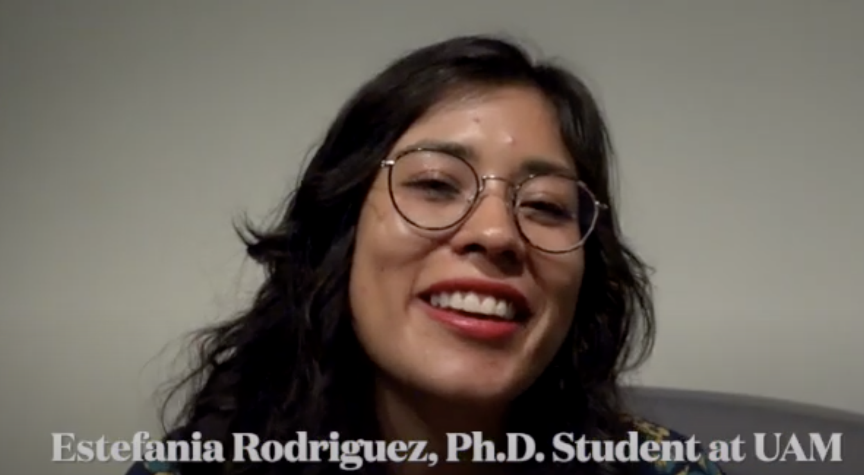

Slide 13
The opportunity: Wings of Love offers three ways to join this Circle of Giving:
CORPORATE and FOUNDATION or INDIVIDUAL CONTRIBUTIONS: Financial support for programs
REGULAR DONORSHIP: Providing high-quality surplus food
VOLUNTEERS: Employee service and “give back” days

Slide 14
CORPORATE CONTRIBUTIONS: Enabling our worldwide WFI programs
YOUR TAX-DEDUCTIBLE CONTRIBUTION
JOIN LEADERS LIKE TC ENERGY
Maintains global operations
Rescues food and saves the environment
Moves women and girls from margin to mainstream
Focuses on areas that food banks do not reach
TC Energy Corporation is a major North American energy company, develops and operates energy infrastructure in Canada, the United States, and Mexico. It has supported
the WFI Wings of Love program since 2023.

